Slide 1

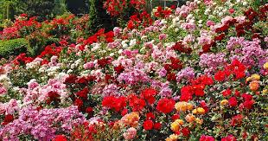
Petals To Metals Classification of TPU
By
Divya Gummadi
Prathyusha Anireddy
Yugender Kolluru

Slide 2

Agenda
Area of Research
Introduction
Motivation
Data Description
Challenges
Strategy
Input Image Size
Pre-Defined Model
Data Augmentation
Techniques
Learning Rate Schedule
Result
Ensemble Learning
Future Work

Slide 3
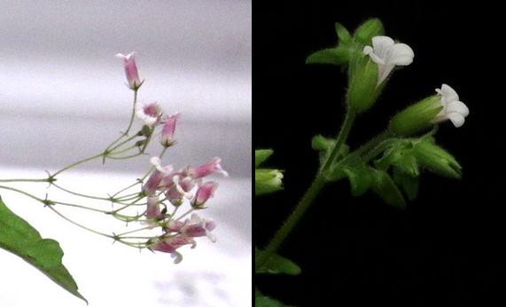
Introduction
What kind of flowers are they? How can the nature of various flowers be determined? How can we tell which kind of flower is most popular?
Due to their similar foliage, it may be challenging to tell these two species apart when they are not in bloom. As observed in this comparative image, the inflorescences, and blooms, while similar,, including color and pedicel length

Slide 4
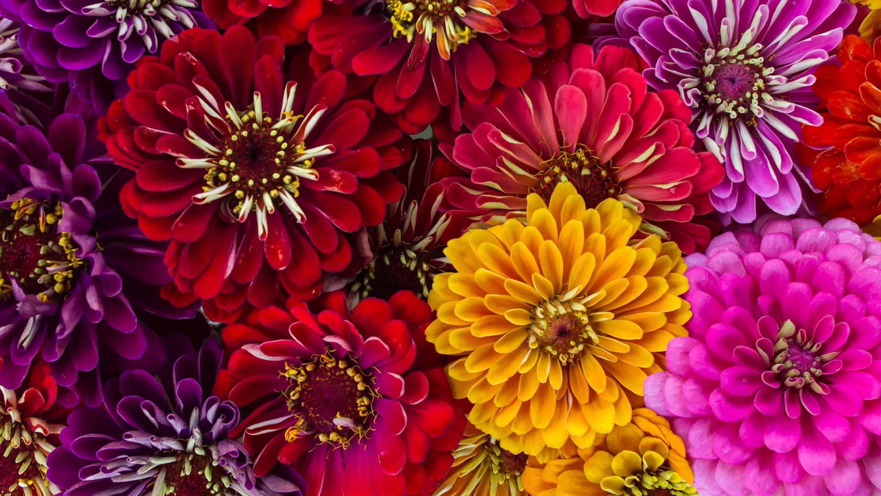
Motivation
We worked to build a machine learning model that identifies the type of flower in a data set of images (for simplicity, we’re sticking to just over 104 types)

Slide 5
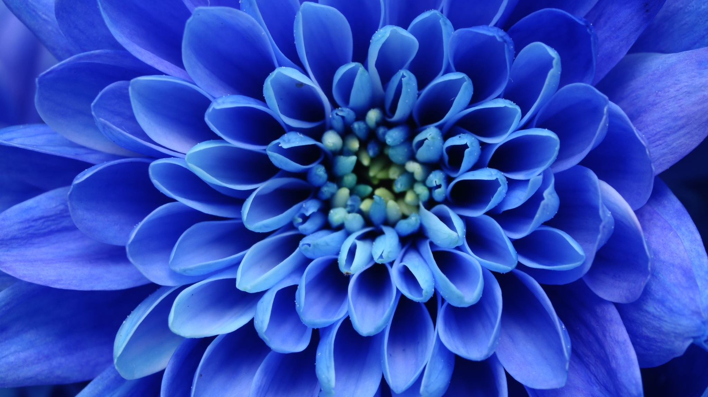
Data Description
There are 12000 flower images from each resolution:
192*192 ,224*224,331*331, 512*512 total is equal 5.15 GB
Where we took Data from?
We took data from Kaggle but the data is in TFRecord Format
What is TFRecord Format
The TFRecord format is a simple format for storing a sequence of binary records.
To organize and shard data files for the best training performance, Tensorflow typically uses the TFRecord container format.
For many photos, each file comprises the id, label (the class of the sample for training data), and img (the information about the actual pixels in array form) fields.
We have Dataset: 12753 training images, 3712 validation images, 7382 unlabeled test images

Slide 6

Challenges
One of the challenges in flower classification is the lack of labeled data which can result in performance loss. Recognizing many classes within one category of flowers is also a challenge. If we have more classes, then combinations of features can improve classification performance
Challenges with TPU
TPU Tends to be idle for the most part of the epoch waiting for training data.

Slide 7

Strategy
To improve the classification accuracy of the model on the test dataset, the following are explored:
Input image size
Pretrained model and number of trainable parameters of the final model
Data augmentation
Regularization techniques
5. Use of learning rate schedule

Slide 8
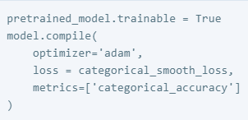
Pretrained Model
For training the model we have used a deep learning technique called Transfer learning with fine tuning means that focuses on storing knowledge gained while solving one problem and applying it to a different but related problem.
Transfer Learning steps:
Take layers from a previously trained model.
Freeze them, to avoid destroying any of the information they contain during future training rounds.
Add some new, trainable layers on top of the frozen layers. They will learn to turn the old features into predictions on a new dataset.
Train the new layers on your dataset.
Fine-tuning is the final, optional step. It entails unfreezing the entire model you received earlier (or a portion of it) and retraining it using the new data at a very slow learning rate. By gradually adjusting the pretrained features to the fresh data, this has the potential to provide significant improvements.

Slide 9
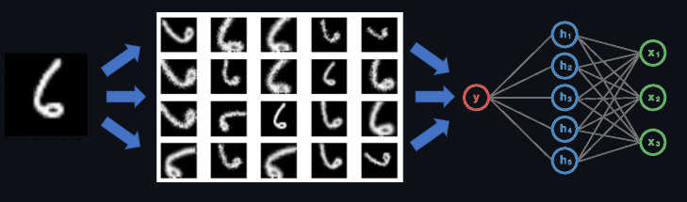
Data Argumentation
With more data available, deep learning neural networks frequently perform better. Image data augmentation is a method for artificially increasing the size of a training dataset by producing altered versions of the dataset's images.

Slide 10
Cont’d
Some of the popular Image Augmentation techniques are :
Flip
Rotation
Scale
Crop
Translation
Adding Gaussian Noise
For this project we have used flip and rotation

Slide 11
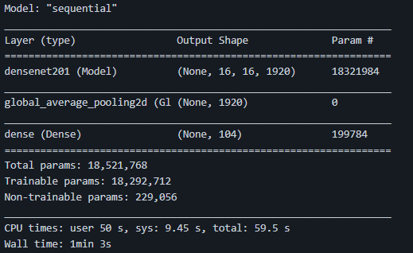
Techniques
Defining the model we have done your project using densenet here is the output

Slide 12
Cont’d
In image from previous slide we took the densenet model with input as the dataset of 512*512 pixel image size
Pre trained model
Transfer learning with fine tuning201 layersBest of 18 models tried with different settings
1.Trained on Imagenet
2.No network tweaks improved performance
3.Hyper-Parameter: Image size , Batch size , Epochs , Folds , Types and amount of data Augmentations ,Learning Rate

Slide 13
Learning Rate Schedule
As mentioned, TPU is idle for the most part of the epoch waiting for training data. We are using Learning Rate Schedule. Adapting the learning rate for optimization procedure can increase performance and reduce training time. These have the benefit of making large changes at the beginning of the training procedure when larger learning rate values are used and decreasing the learning rate and therefore smaller training updates are made to weights later in the training procedure.
This has the effect of quickly learning good weights early and fine tuning them later . Two popular and easy to use learning rate schedules are as follows:
Decrease the learning rate gradually based on the epoch.
Decrease the learning rate using punctuated large drops at specific epochs. It might be difficult to distinguish between numerous classes of flowers that fall under one category.
Combinations of characteristics can enhance classification performance if there are more classes.

Slide 14
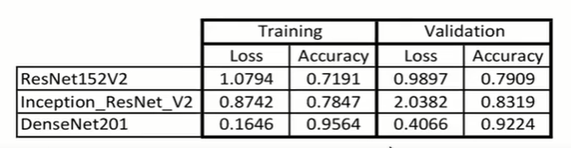
Comparison of Transfer Learning Models

Slide 15
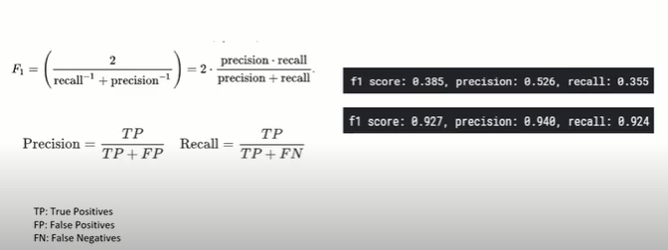
F1 Score

Slide 16
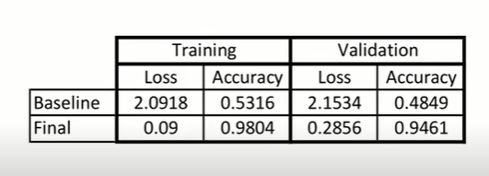
Improvement

Slide 17
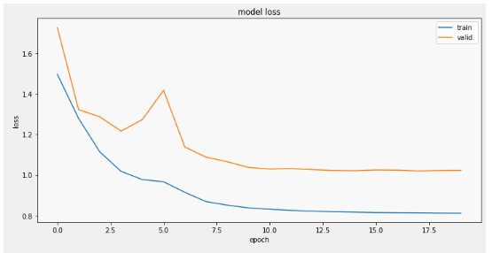
Graph for Model Loss

Slide 18
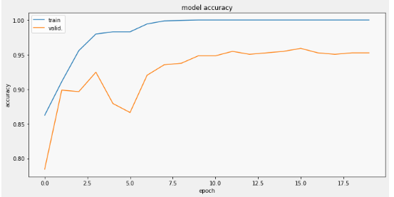
Graph for model accuracy

Slide 19
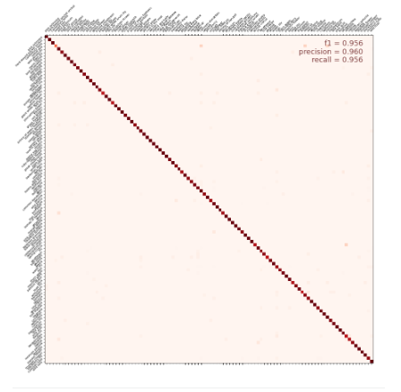
Confusion Matrix
104 Kinds of Flowers
Accuracy Visualized
Flower on the left identified as flower on top
The diagonal indicates correct Choices

Slide 20
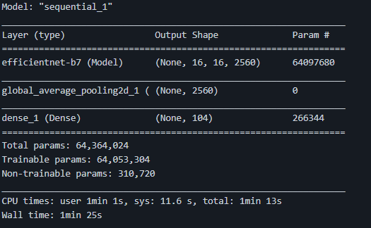
Ensemble Learning
Allows us to combine the decisions from multiple models
Stucks to simple weighted average of the predictions of the models
The Ensemble models used in our model are DenseNet and Efficient Net

Slide 21
Result
Model | Accuracy
Vgg16 | 39.5%
DenseNet | 92.95%
EfficientNet | 93.2%
Ensemble Learning | 94%

Slide 22

Future Work
Use more Networks
More Data augmentation
Train Ensemble as one network, end to end

Slide 23

Any Questions

Slide 24


